Slide 1

Lambda Function in Manual
Presented By Team-3

Slide 2
INDEX 1. Introduction Lambda 2. Key Features Of AWS Lambda 3. Benefits of AWS Lambda 4. Setup for Creating Lambda Function 5. Configuration Options 6. Code Description and Explanation 7. Lambda Function Code 8. Testing the Function 9. Monitoring 10. Conclusion

Slide 3
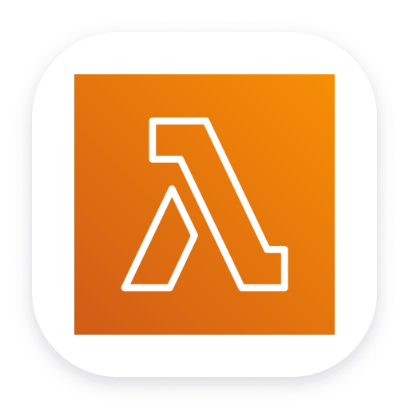
Introduction
AWS Lambda is a serverless computing service that Amazon Web Services (AWS) provides. It allows you to run code without provisioning or managing servers. AWS Lambda executes your code in response to events and automatically scales based on the number of requests.
Lambda

Slide 4
Key Features of AWS Lambda
No Server Management – AWS handles infrastructure, scaling, and maintenance.
Event-Driven – Triggers from AWS services like S3, DynamoDB, API Gateway, etc.
Automatic Scaling – Scales up or down based on demand.
Pay-Per-Use – You are charged only for the execution time.
Supports Multiple Languages – Python, Node.js, Java, C#, Go, Ruby, etc.

Slide 5
Benefits of AWS Lambda
AWS Lambda offers several advantages for developers and businesses:
No Server Management:
No need to manage servers. AWS handles the infrastructure.
Automatic Scaling:
Scales based on incoming requests and manages thousands of concurrent executions.
Cost-Effective:
Pay only for execution time (in milliseconds). Free tier available (1 million requests/month).
High Availability:
Built-in redundancy across AWS Availability Zones ensures high availability.
Event-Driven Execution:
Triggers from various AWS services, running only on events to minimize costs.

Slide 6
Supports Multiple Languages:
Works with languages like Python, Node.js, Java, and more.
Security & IAM Integration:
Fine-grained access control and secure execution with VPC integration.
Easy Monitoring:
Real-time monitoring with AWS CloudWatch and debugging with X-Ray.
Faster Development:
Focus on code without managing infrastructure, integrates with CI/CD pipelines.
Seamless AWS Integration:
Works with various AWS services and fits into microservices or serverless applications.

Slide 7
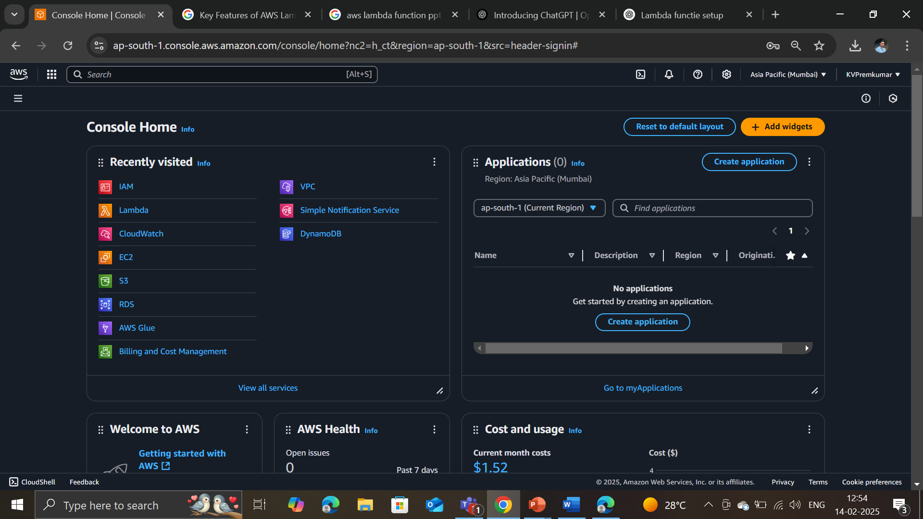
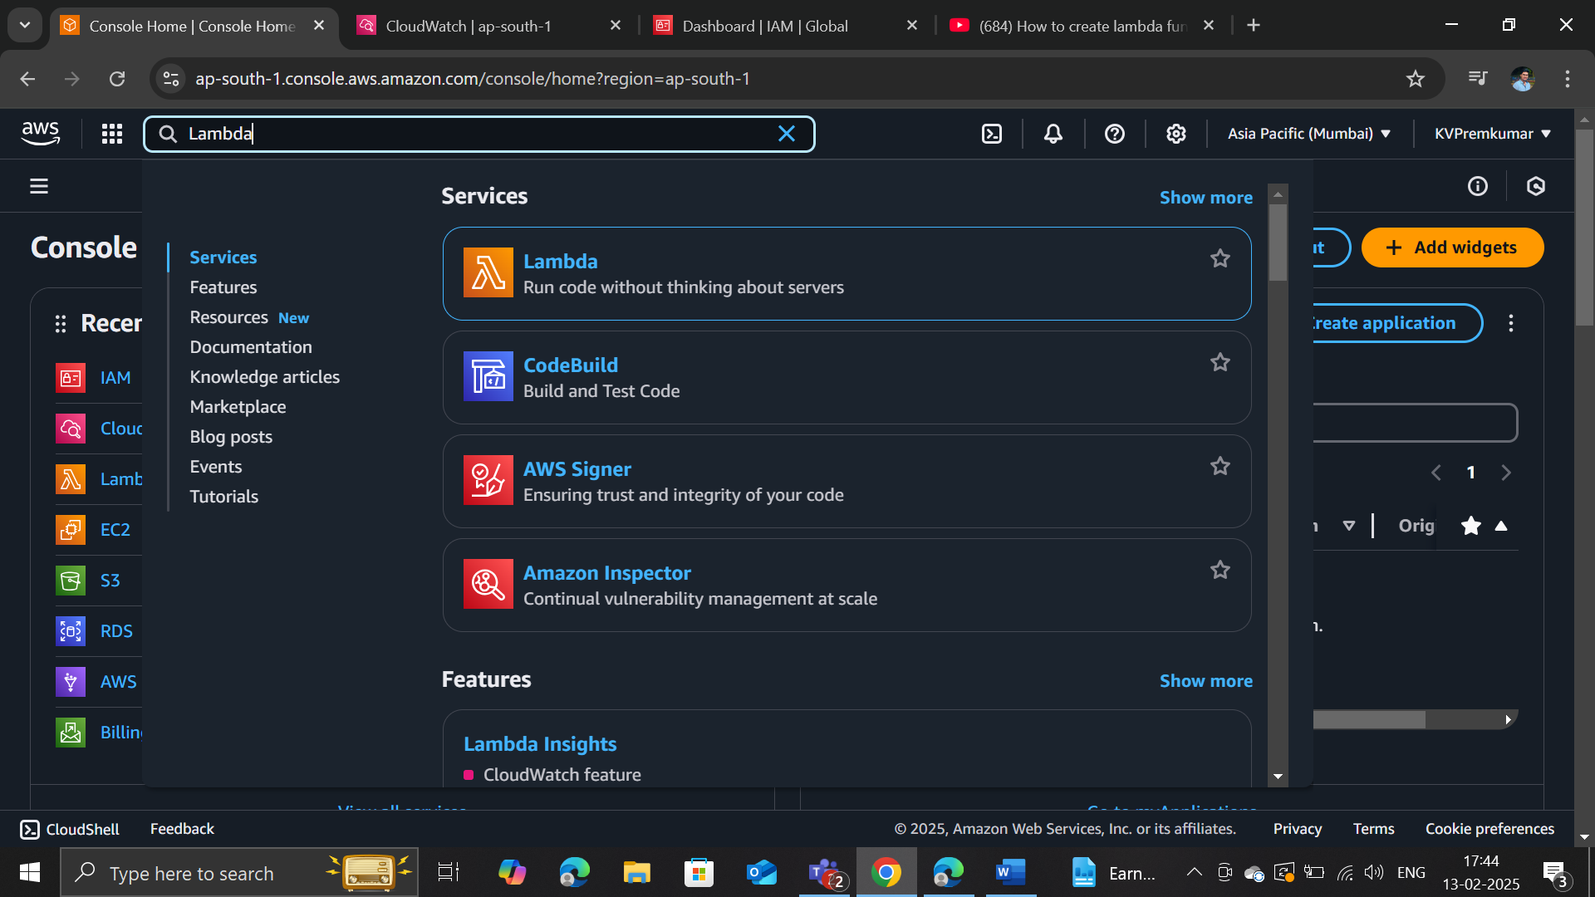
Setup for Creating Lambda Function
Log in to AWS Console.
Navigate to AWS Lambda service.

Slide 8
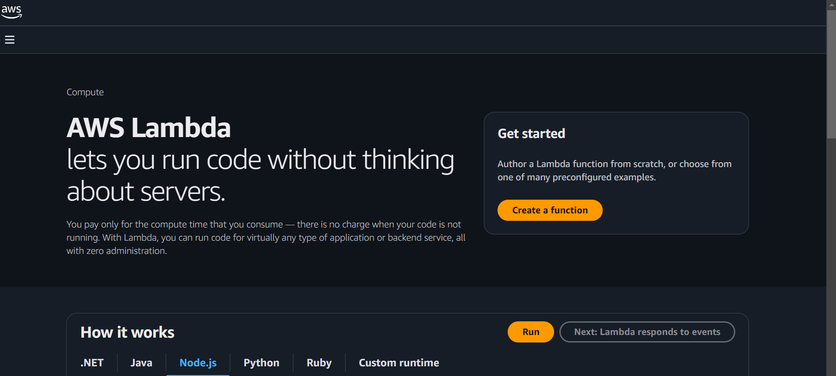
Click on 'Create function’.

Slide 9
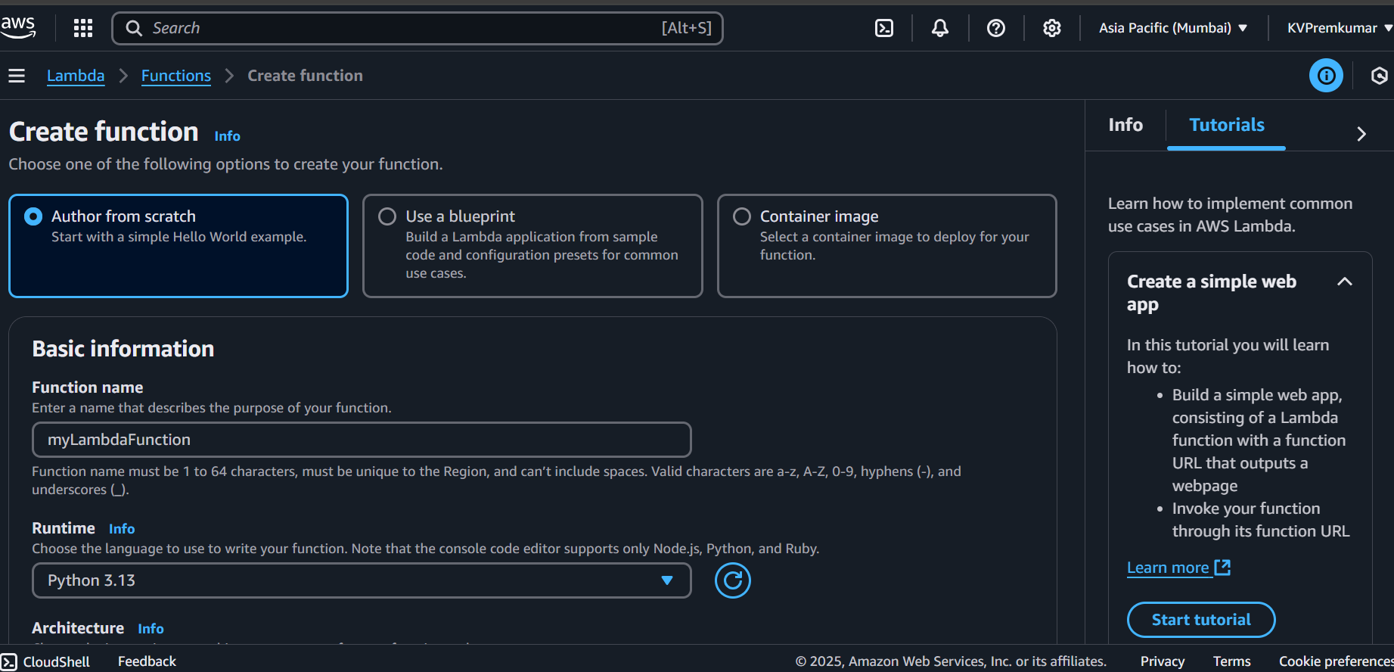
Configuration Options
Choose: 'Author from scratch' or use a blueprint.
Define function name 'myLambdaFunction'.
Select runtime (Python, Node.js, Java, etc.).

Slide 10
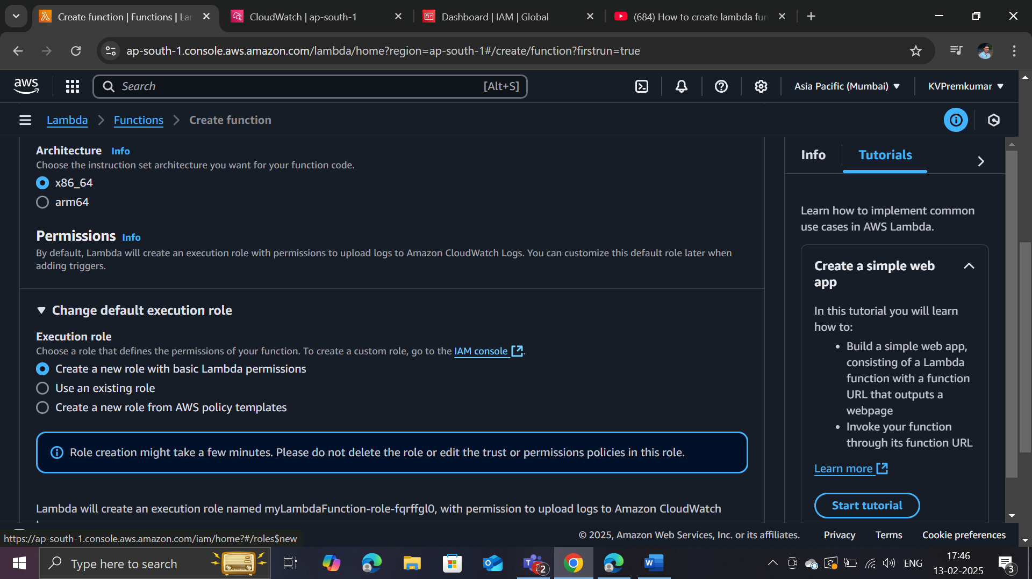
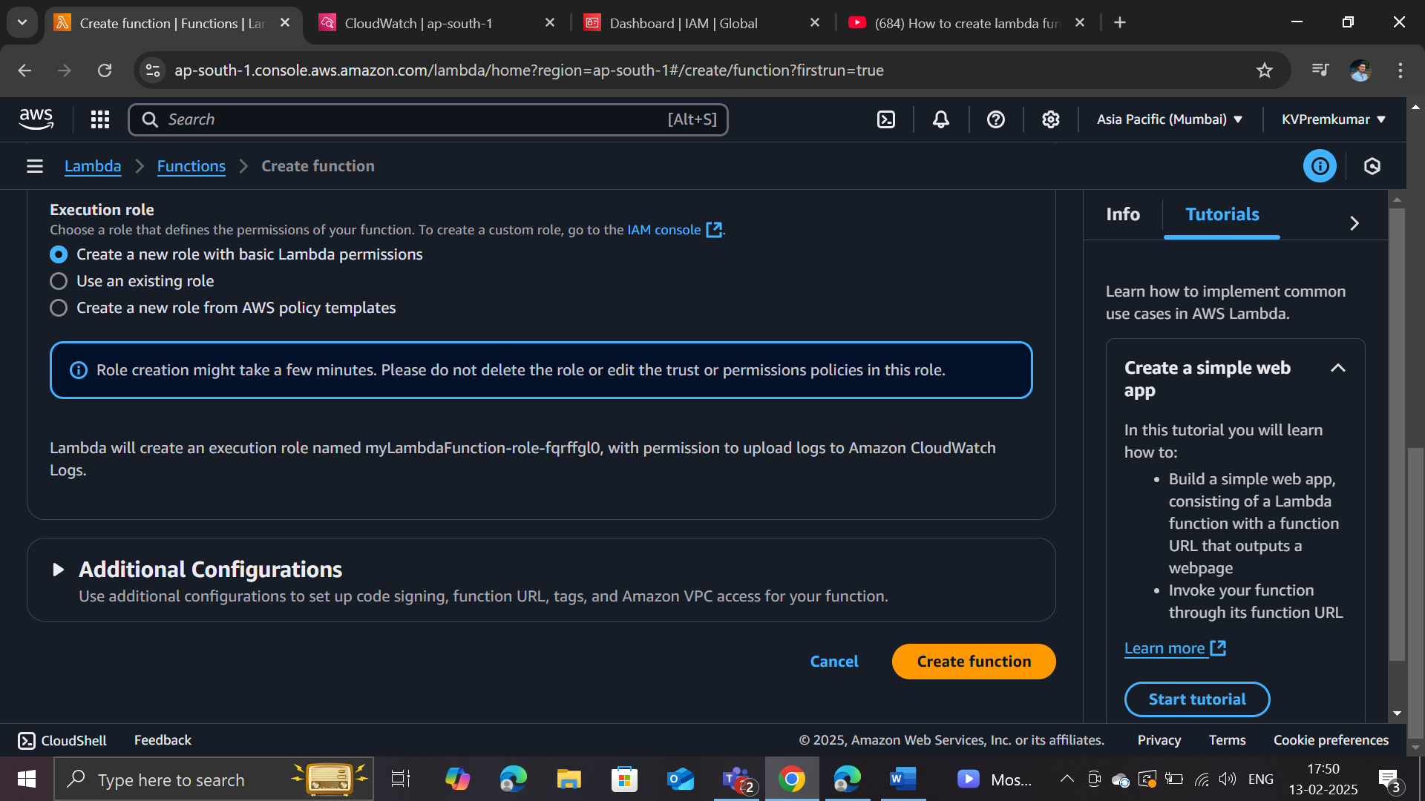
Select the Architecture 'x86_64'.
Assign an execution role 'Create a new role with Lambda Permissions’.
Click on ‘Create function’.

Slide 11
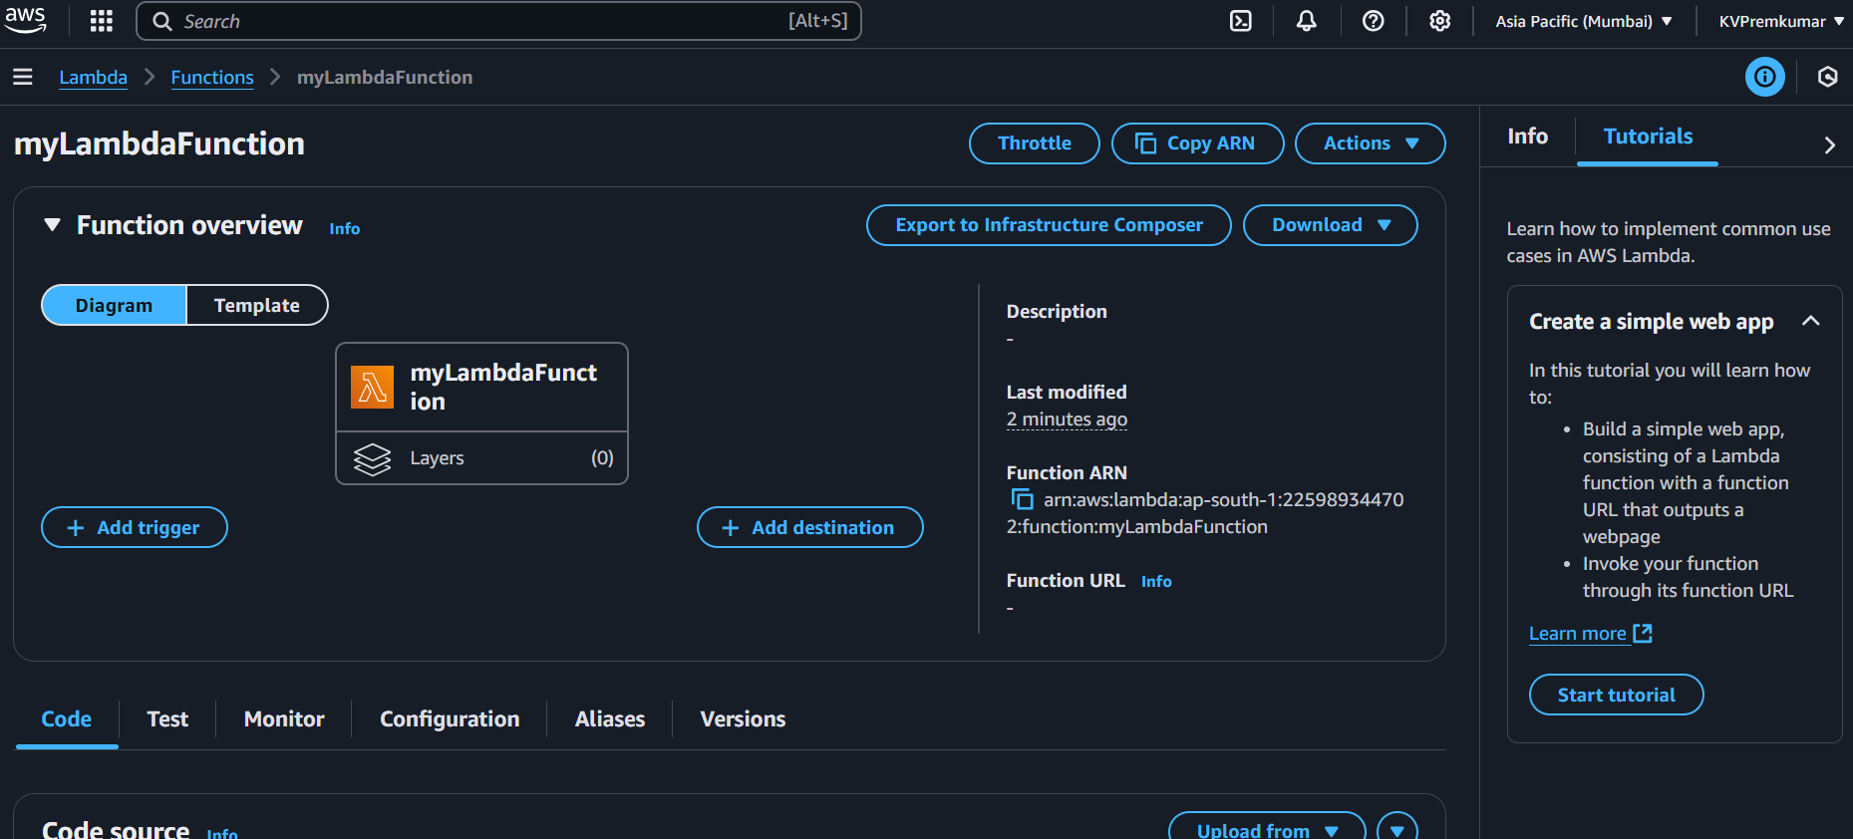
The function has been created successfully.
Note: IAM roles are used in AWS Lambda to securely grant permissions for accessing other AWS services.

Slide 12
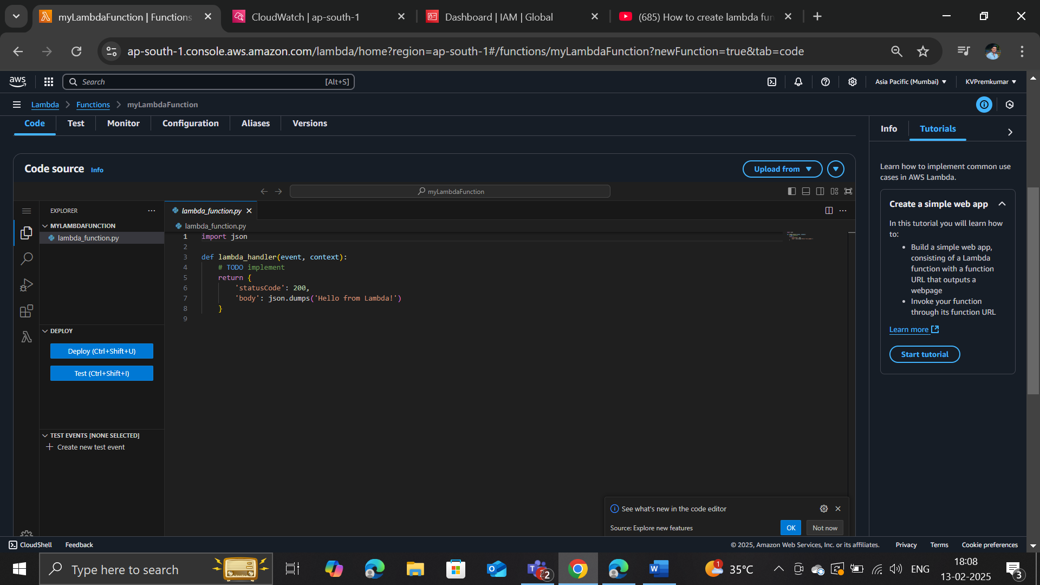
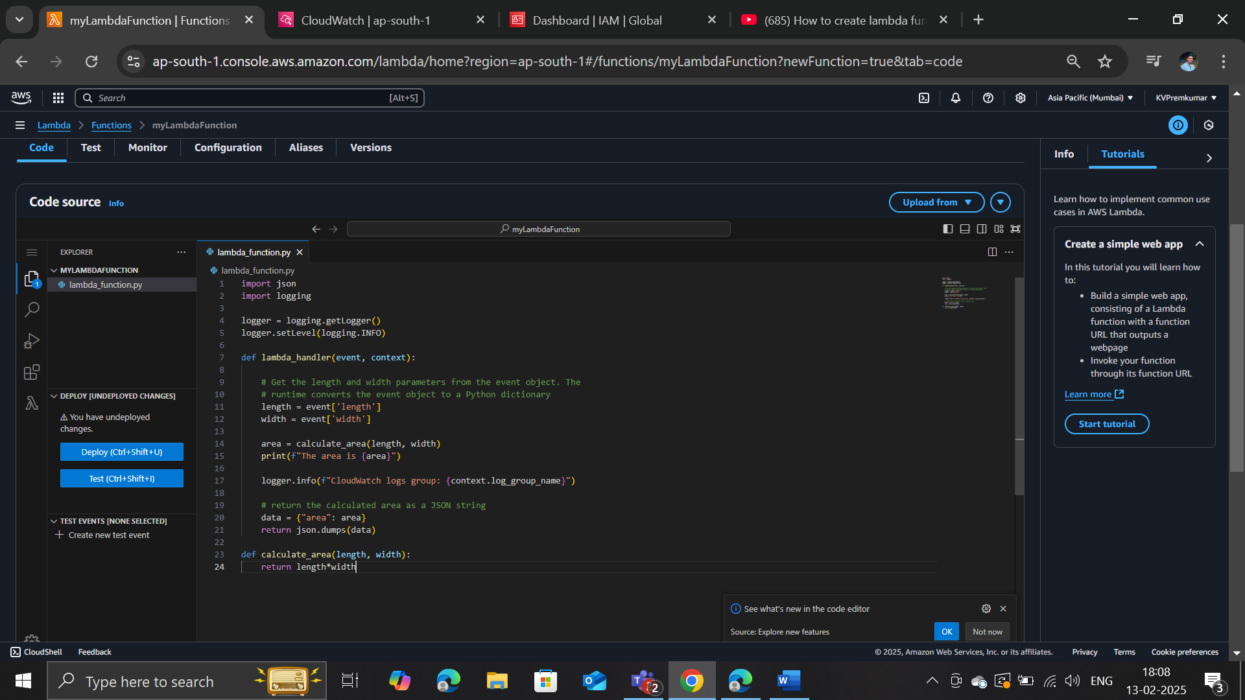
Code Description and Explanation
Scroll down to view the default JSON code presented below.
Modify the code to accurately calculate the ‘area of a rectangle’ by using ‘length and width’.

Slide 13
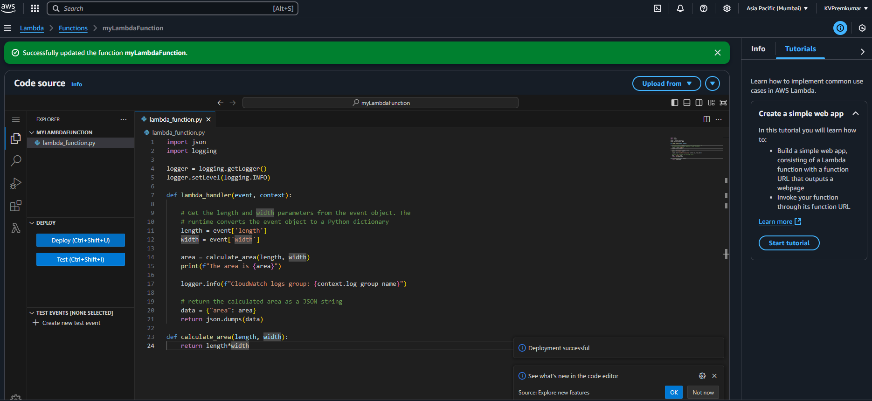
Click on ‘Deploy’ the code to update the function.
Note: We can also utilize an ‘inline editor’ or ‘upload a .zip file’.

Slide 14
Lambda Function Code
import json
import logging
logger = logging.getLogger()
logger.setLevel(logging.INFO)
def lambda_handler(event, context):
length = event['length']
width = event['width’]
area = calculate_area(length, width)
print(f"The area is {area}")
logger.info(f"CloudWatch logs group: {context.log_group_name}")
data = {"area": area}
return json.dumps(data)
def calculate_area(length, width):
return length*width

Slide 15
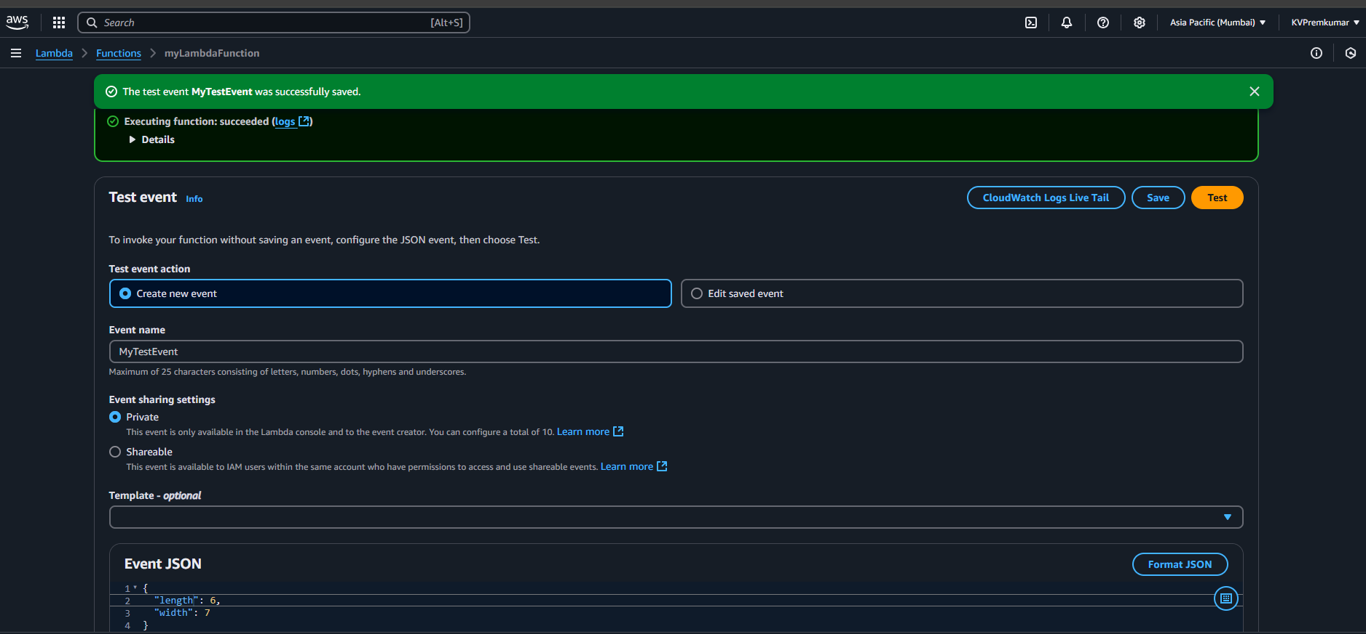
Testing the Function
Create a test event
Define event name ‘myTestEvent’.
Edit the parameters in the Event JSON.
Save and Run the function.

Slide 16
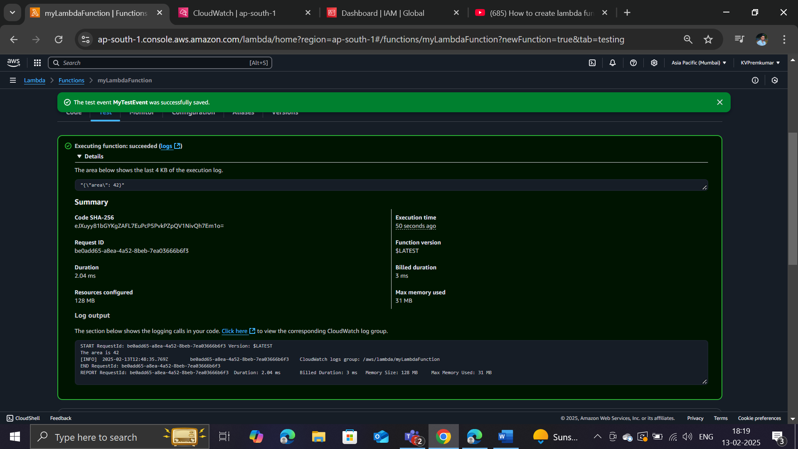
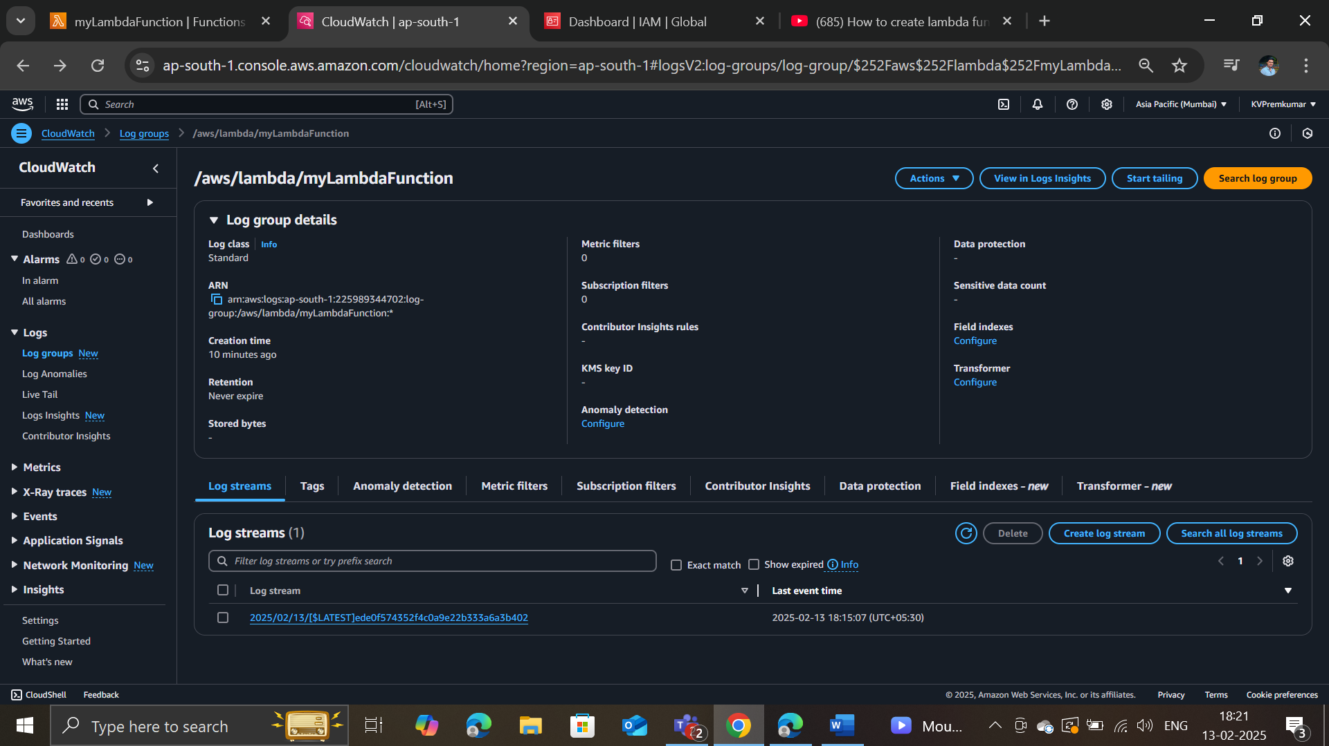
Monitoring
View Output details in Executing function.
View the recorded logs stored in CloudWatch under the Log streams.

Slide 17
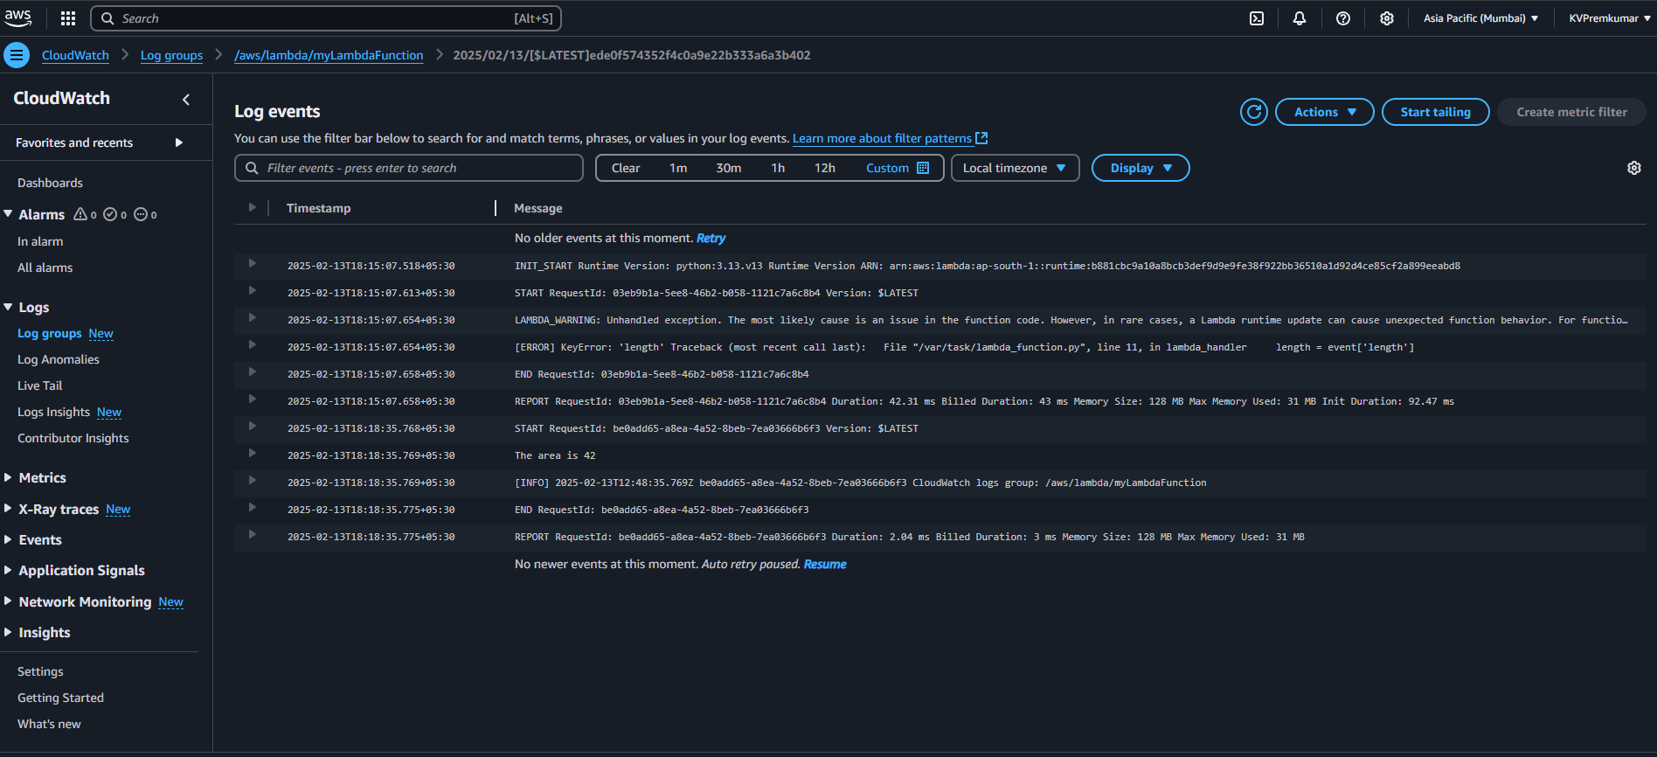
Final Output is displayed in Log events.
Note: AWS CloudWatch Logs automatically stores these logs, helping you debug and monitor your function’s performance.

Slide 18
Conclusion
AWS Lambda provides a scalable, cost-effective, and event-driven solution for running serverless applications.
Key Takeaways:
✔ No need to manage servers
✔ Automatic scaling
✔ Secure and integrates well with AWS services
✔ Ideal for real-time processing and automation

Slide 19
Thank You
Presented by Team-3

